Slide 1
Introduction of
INTELLECTUAL PROPERTY RIGHTS
行政機關應有之智慧財產權常識教育
Hsin-An Yao
Dept. of Financial & Economic Law
Assoc. Prof.

Slide 2
Intellectual Property Rights
Copyright
Patent
Trademark
Trade Secret

Slide 3
Copyright
& right holders

Slide 4
Subject Matters of Copyright
Oral and literary works
Musical works
Dramatic and choreographic works
Artistic works
Photographic works
Pictorial and graphical works
Audiovisual works
Sound recordings
Architectural works
Computer programs
Performance (of pre-existing work or folklore)

Slide 5
Special forms (relationship)
  Joint work
    Completed by two or more persons where the creation of each person cannot be separately exploited.
  Derivative work
    A creation adapted from one or more pre-existing works is a derivative work and shall be protected as an independent work.
  Compilation work
    A compilation work is a work formed by the creative selection and arrangement of materials, and shall be protected as an independent work.

Slide 6
Copyright
Art. 10 (of Copyright Law):
“The author of a work shall enjoy copyright upon completion of the work.”
Art. 3 Sec. 1 Subsec. 3:
“"Copyright" means the moral rights and economic rights subsisting in a completed work.”
Works should have originality and creativity.

Slide 7
Copyright
Moral rights
Economic rights

Slide 8
Copyright
Moral Right
Right to publicly release the work
Right to indicate its name
(official name/pseudonym/no name)
Right to prohibit improper change of the work
(The author has the right to prohibit others from distorting, mutilating, modifying, or otherwise changing the content, form, or name of the work, thereby damaging the author's reputation.)

Slide 9
Copyright
Economic rights
1. Right to reproduce
2. Right to publicly broadcast
3. Right to publicly transmit
4. Right to adapt
5. Right to compile
6. Right to distribute
7. right to rent

Slide 10
Copyright
Economic rights (for specific works)
1. Right to publicly recite (oral and literary works)
2. Right to publicly present (audiovisual work)
3. Right to publicly perform (oral and literary, musical, and dramatic/choreographic works)
4. Right to publicly display (unpublished fine arts or photographic works)

Slide 11
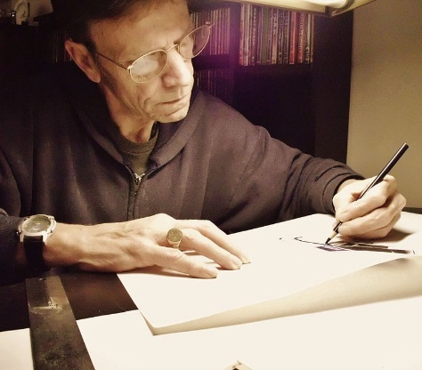
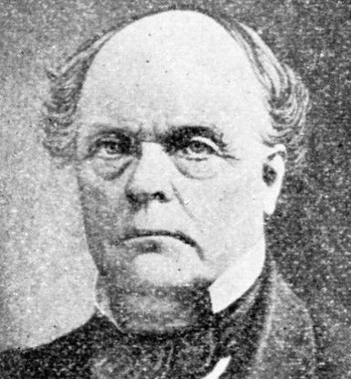
Art. 11: ” Where a work is completed by an employee within the scope of employment, such employee is the author of the work; provided, where an agreement stipulates that the employer is the author, such agreement shall govern.
Where the employee is the author of a work pursuant to the provisions of the preceding paragraph, the economic rights to such work shall be enjoyed by the employer; provided, where an agreement stipulates that the economic rights shall be enjoyed by the employee, such agreement shall govern.”
Employee
Employer

Slide 12
Employment
Employer
Employee
Work
Holder of Economic rights
Author
(Economic rights)
(Moral rights)

Slide 13
Employment
Employer
Employee
Work
Author
(Moral rights)
(Economic rights)

Slide 14
Art. 12: ” Where a work is completed by a person under commission, except in the circumstances set out in the preceding article, such commissioned person is the author of the work; provided, where an agreement stipulates that the commissioning party is the author, such agreement shall govern.
Where the commissioned person is the author pursuant to the provisions of the preceding paragraph, enjoyment of the economic rights to such work shall be assigned through contractual stipulation to either the commissioning party or the commissioned person. Where no stipulation regarding the enjoyment of economic rights has been made, the economic rights shall be enjoyed by the commissioned person.”

Slide 15
Commission
Commissioning
Person
Commissioned
Person
Work
Author
（Moral Rights)
（Economic Rights)

Slide 16
Commission
Commissioning
Person
Work
Commissioned
Person
Holder of
Economic Rights
Author
（Economic Rights)
（Moral Rights)

Slide 17
copying
/
Plagiarism

Slide 18
Copying?
In the copyright law, “Copying” means the copying of specific expression of other’s copyrighted work, including reproduction, adaptation or other ways of copying, but not the copying of some idea of other’s work.
。

Slide 19
Copying?
Elements of Copying
Copying
∥
Substantial Similarity
＋
Access

Slide 20
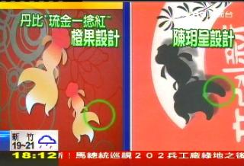
Copying?
IP Court (appeal)
【Rule】
Substantial Similarity:
high degree of SS
Access: high possibility of access
Both P & D were alumna of the same school.
P’s work was displayed in 2 exhibitions & on a website.
【Outcome】
P prevailed >> D infringed P’s copyright.

Slide 21
Legitimate ways to use copyrighted materials

Slide 22
Legitimate Ways to Use
Licensing
Public Domain
Fair Use

Slide 23
Licensing

Slide 24
Types & Ways to License
Q. What’s Licensing?
An agreement through which a licensee leases the rights to a legally protected piece of intellectual property from a licensor

Slide 25
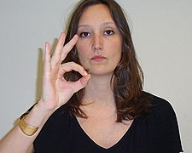

Types & Ways to License

Slide 26
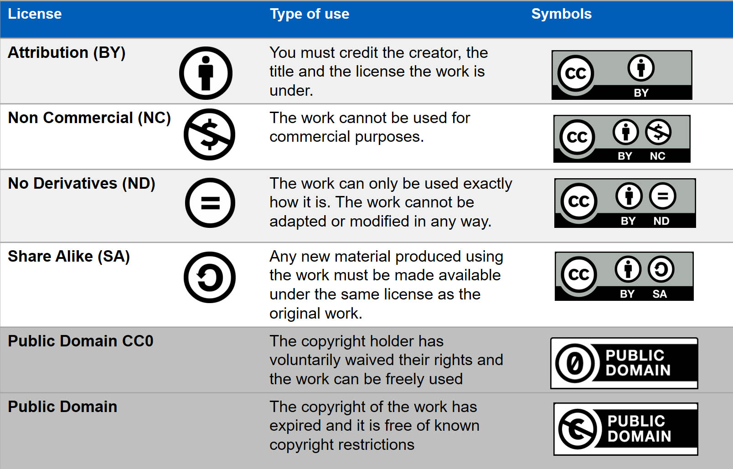
Types & Ways to License
Creative Commons

Slide 27
Types & Ways to License
Orphan Works
Development of the Cultural and Creative Industries Act Art. 24 Sec. 1:
“If a copyright user uses its best effort but fails to obtain a valid authorization from the copyright owner due to either the identity or the location of the copyright owner being unknown, the user shall clarify the reason for its failure to obtain such valid authorization to the copyright competent authority. After the completion of an investigation conducted by the copyright competent authority and if as a result of the investigation the user has obtained the permission and authorization from the copyright competent authority, the user may utilize the work within the permitted scope if it has withdrawn the amount needed for usage remuneration.

Slide 28
Public domain

Slide 29
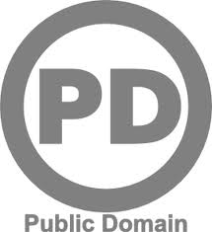
Public Domain
“Expired” Works
Works Not Protected by Law

Slide 30
“Expired” works

Slide 31
“Expired” Works
Copyright Law Art. 31 Sec. 1: ” Except as otherwise provided in this Act, economic rights endure for the life of the author and fifty years after the author's death.” (for natural person > authors/humanity)
Copyright Law Art. 33: ” Economic rights in works authored by a juristic person endure for fifty years after the public release of the work .” (for juristic person > companies/organizations)

Slide 32
“Expired” Works
Copyright Law Art. 34 Sec. 1: “Economic rights for photographic works, audiovisual works, sound recordings, and performances endure for fifty years after the public release of the work.”
Copyright Law Art. 35 Sec. 1: “All terms of duration specified in Articles 30 through 34 terminate as of the last day of the last year of the term.”

Slide 33
“Expired” Works
Copyright Law Art. 42: “Economic rights are extinguished upon expiration of the term of protection.”
Copyright Law Art. 43: ” Except as otherwise provided by this Act, any person may freely exploit a work for which the economic rights have been extinguished.”
Public Domain/Public Property

Slide 34
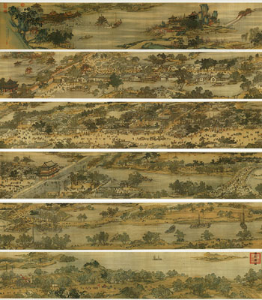
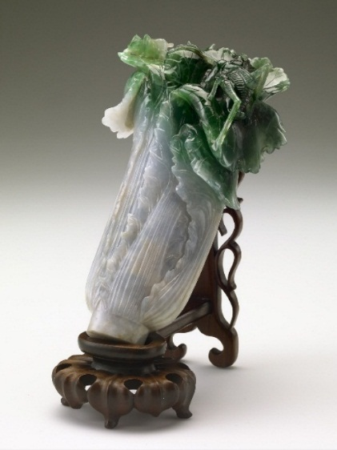
Is A Cultural Ralic Copyrighted？
(Along the River During the Qingming Festival)
(Jade Cabbage)
If original, but expired,
no copyright protection.

Slide 35
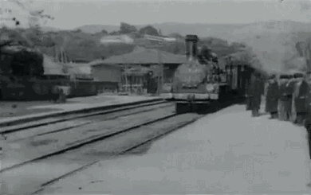
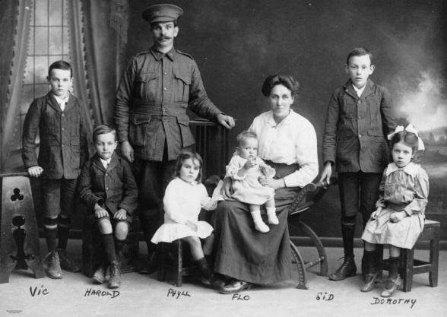
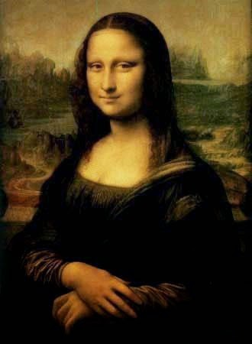
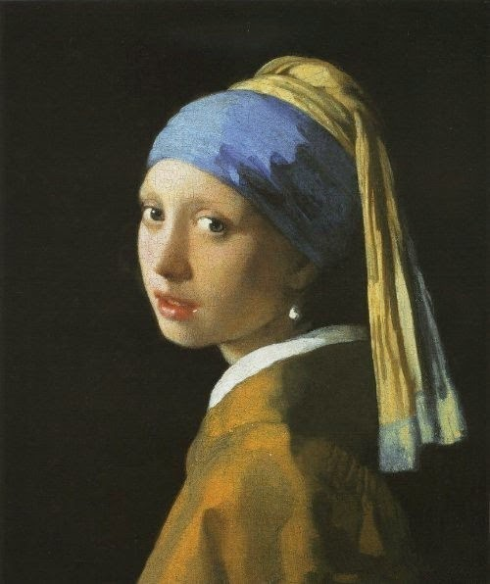
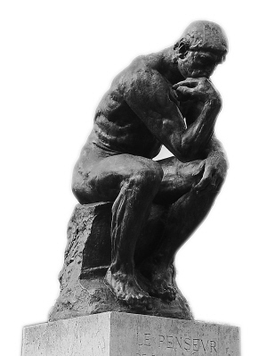
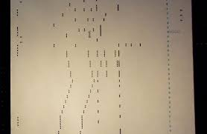
PD: Where to Find?
Works before 1923 AD.

Slide 36
PD: Where to Find?
- Wikipedia：Public Domain Resources
- Wikimedia Commons
(http://commons.wikimedia.org/wiki/Main_Page)
- Works of the U.S. Federal Government
( http://www.house.gov/)

Slide 37
Yet, … …
Copyright Law Art. 18：
” The protection of moral rights of an author who has died or been extinguished shall be deemed to be the same as when the author was living or in existence and shall not be infringed upon by any person.”
  Means … TW Copyright Law permanently protects an author’s moral rights.

Slide 38
Works Not Protected by Law

Slide 39
Works Not Protected by Law
Copyright Law Art. 9: “The following items shall not be the subject matter of copyright:
1.The constitution, acts, regulations, or official documents.
2.Translations or compilations by central or local government agencies of works referred to in the preceding subparagraph.
3.Slogans and common symbols, terms, formulas, numerical charts, forms, notebooks, or almanacs.
4.Oral and literary works for news reports that are intended strictly to communicate facts.
5.Test questions and alternative test questions from all kinds of examinations held pursuant to acts or regulations.
The term "official documents" in the first subparagraph of the preceding paragraph includes proclamations, text of speeches, news releases, and other documents prepared by civil servants in the course of carrying out their duties.”

Slide 40
Fair use

Slide 41

Fair use of a work shall not constitute infringement on economic rights in the work.
（Copyright Law Art. 65 Sec. 1)

Slide 42
Elements of FU
1. The purposes and nature of the exploitation
2. The nature of the work
3. The amount and substantiality of the portion
4. Effect of the exploitation on the work's current and potential market value

Slide 43
1. The purposes and nature of the exploitation
Whether such exploitation is of a commercial nature or is for nonprofit educational purposes?
Commercial
High possibility
Nonprofit
Low possibility

Slide 44
2. The nature of the work
The nature of the work exploited.
Depending on the degree of originality/creativity of the work.
High creativity
High possibility
Law creativity
Low possibility

Slide 45
3. The amount and substantiality of the portion exploited
Small amount
High possibility
Big amount
Low possibility
Even if the amount of the portion exploited is small, the use will still be “unfair” if the portion is the key or heart of the work.

Slide 46
4. Effect of the exploitation on work's market value
Including the work’s current and potential market value.
High effect
High possibility
Low effect
Low possibility

Slide 47
FIN
Thank you for listening

